Slide 1
Ansible
Ansible is powerful IT automation that you can learn quickly. It's simple enough for everyone in your IT team to use, yet powerful enough to automate even the most complex deployments. Ansible handles repetitive tasks, giving your team more time to focus on innovation.
Simple. Powerful. Agentless.
You can use Ansible to automate three types of tasks:
Provisioning: Set up the various servers you need in your infrastructure.
Configuration management: Change the configuration of an application, OS, or device; start and stop services; install or update applications; implement a security policy; or perform a wide variety of other configuration tasks.
Application deployment: Make DevOps easier by automating the deployment of internally developed applications to your production systems.

Slide 2
Feature of Ansible
Open Source
Written in Python, so it's easy to read and extend
Easy installation and configuration
Highly Scalable
Agent Less Client Configuration
Requirement for Ansible
SSH Client(OpenSSH)
Python (PyYAML, Jinja2)
Components of Ansible
Program
- ansible
- ansible-doc
- ansible-playbook
- ansible-pull
Modules
- Perform configuration and system management
Example: Modules copy,service,file,yum,user,group.
Ansible is push Mechanism

Slide 3
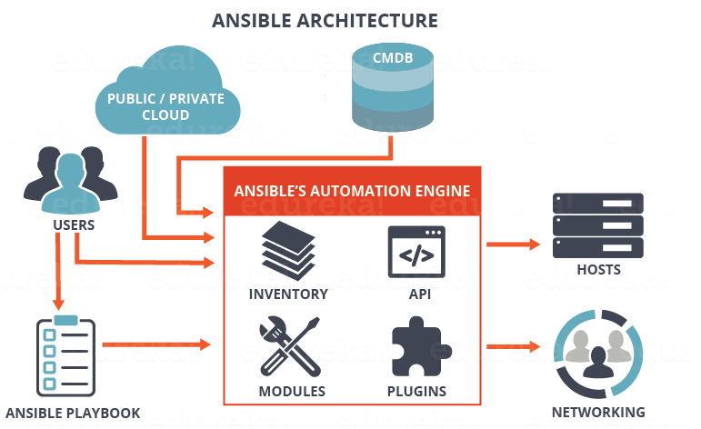

Slide 4
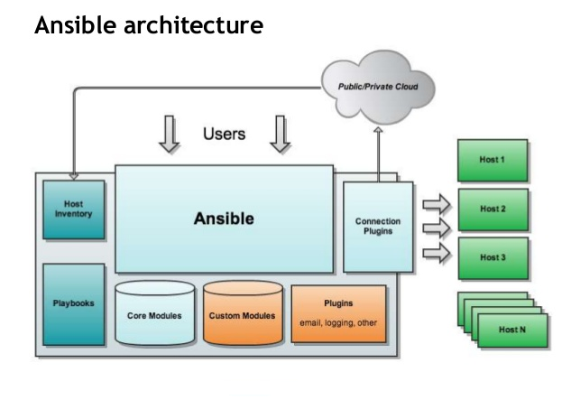

Slide 5
Lab Details
Server Name | IP Address | Description
Ansible control server |  | control server
Web server |  | node server 1
App server |  | node server 2

Slide 6
Inventory
Inventory file location is /etc/ansible/hosts
$ ansible -m ping all
$ ansible webservers -m ping
$ ansible-playbook 2.yml
Generate key file
$ ssh-keygen –t rsa
Put the key file in /home/ec2-user/.ssh/authorized_keys
Same key file we need to paste web,app server
Node1 ansible_user =ec2-user
Node2 ansible_user =ec2-user
ssh node1

Slide 7
[ groupname ] → it represent the ansible group name
/etc/ansible/ansible.cfg → it represent the ansible configuration file
Modules
$ ansible-doc –l
$ ansible-doc -l | wc – l ( get ansible module count )
$ ansible-doc -s yum ( get ansible specific module info )
$ ansible webservers –m ping ( this command will ping servers under webserver group)
$ ansible all –m ping ( this command will ping all servers )
$ ansible all –m ping -o ( this command will ping all servers )
Get Machine Configuration
$ ansible all –m shell -a “uname –a;df –h” –v
$ ansible webservers -m yum -a "name=httpd state=present" --sudo

Slide 8
To start webserver all webservers machines
$ ansible webservers -i inventory_prod -m service -a "name=httpd state=started enabled=yes" --sudo
verify the web server
$ systemctl nginx status
$ ansible webservers -m service -a "name=httpd state=started" --sudo
$ ansible webservers -m copy -a "src=/tmp/test1 dest=/tmp/test1“ -s
Playbook
Ansible playbooks are a way to send commands to remote computers in a scripted way.
Instead of using Ansible commands individually to remotely configure computers from the command line, you can configure entire complex environments by passing a script to one or more systems.
Ansible playbooks are written in the YAML data serialization format.

Slide 9
sudo pip install boto --upgrade

